Slide 1



TouchDesigner Workshop Sensors and OSC
20-4-2024 Creative Coding Utrecht
by Digital Piglet (Raul Leal)

Slide 2
Hi my name
is Raul Leal

Slide 3
Coming up
Utrecht CCU
25th April TouchDesigner meetup
Berlin
22-23 May – European TouchDesigner event- Also online
Amsterdam
28 May – TouchDesigner meet up (Amaze/y=f(x))
Online
NODE institute - Summer sessions 2024

Slide 4
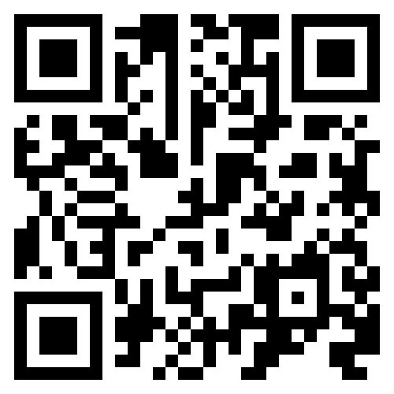
Practial Info
WIFI: CCU
WW: Code03084
https://discord.gg/gP4c43Yg

Slide 5

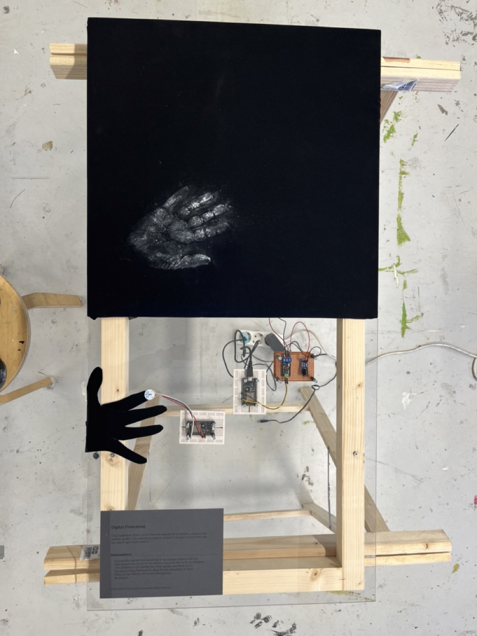
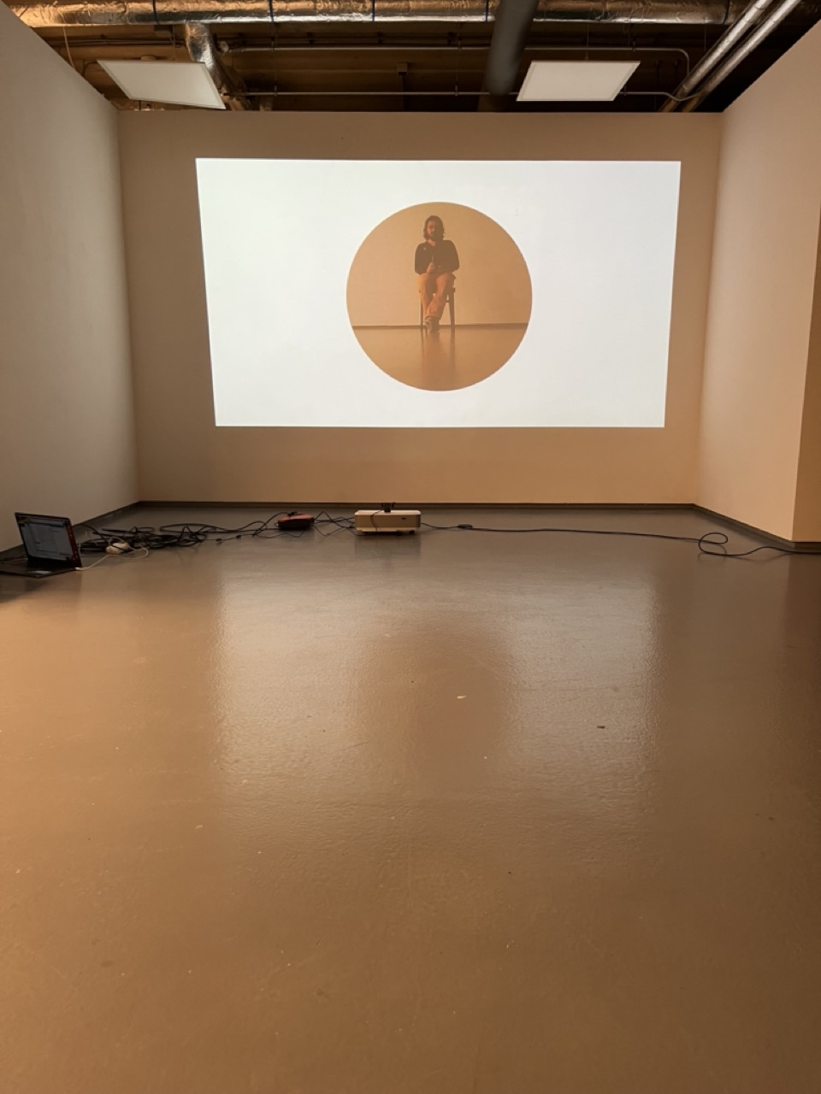
Me
Creative technologist
Rietveld – DogTime Unestable Media
In my practice I aim to use technology as companion for creation instead of simply as a tool

Slide 6
This workshop
What will do
What we will not do
Basic Introduction
Connecting things to TouchDesigner
Common patterns to process data
Assigning references
Interactive Bauhaus motion graphics
Get physical and have fun
No 3D
No Particles
No Kinect

Slide 7

The workshop structure
Intro
Arduino with a cable
Touch OSC
ESP8266
OSC Basic Communication
Firmata
Serial
Sending messages
Receiving messages

Slide 8
Constrains for the workshops…
It is done in
TochDesigner and...
Only uses...
Only uses...
It is an interactive 2d animation,
i.e no 3d scenes, objects etc..

Slide 9
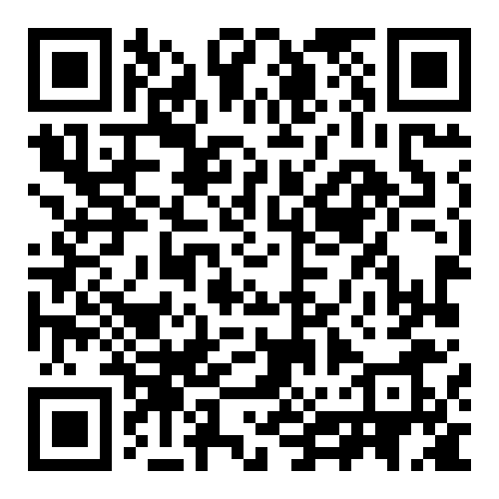
Git repository for these workshops
https://github.com/Rauleal/TouchDesigner_Bauhaus_workshop

Slide 10
Firmata protocol
Arduino library for communication with Arduino boards.
Good to send data to the board and control devices that do not need logic.
Not so good to receive detailed data
For TD it needs a cable

Slide 11
Serial protocol
The basic communication protocol for Arduino boards
Very good to get detailed data from sensors
Quite some work to send data back to the board
It needs a cable

Slide 12
Hands on
Use your sensor set-up to make your animation interactive

Slide 13
Open Sound Control (OSC)
Protocol based on messages which can be transported across the internet.
You do not need cables, just the same WiFi and open ports.
Standard message build up to send and receive message
Out of the box TD need to send and receive messages
Nowadays many apps integrate OSC communication

Slide 14
TouchOSC
A touchscreen MIDI and OSC control app
Very stable
Integrates with everything

Slide 15
Hands on
Make a touchOSC interface to make your animation interactive

Slide 16
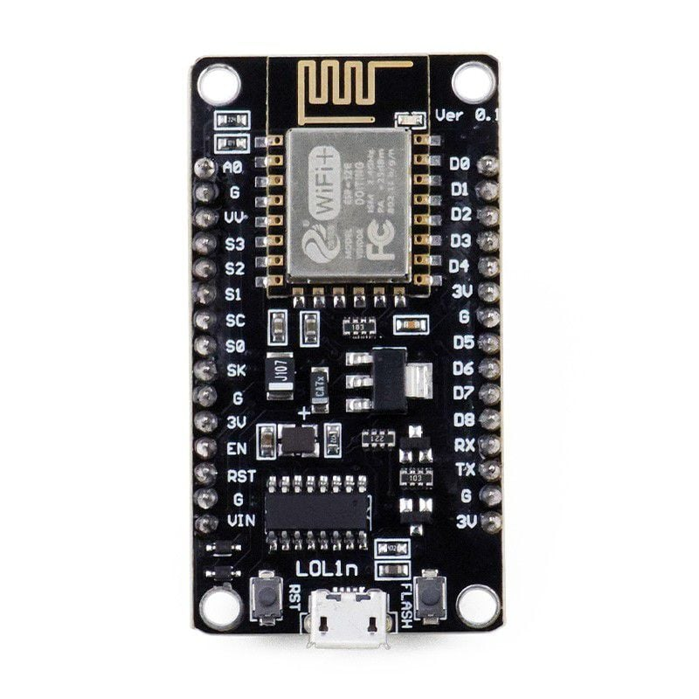
ESP8266
Cheap microcontroller alternative to arduino
Arduino cost 14 to 30 euros, this one costs 4 to 6 euros
Integrated WiFi and Bluetooth connectivity
you can connect wirelessly
Ideal to connect things to a Mac

Slide 17
ESP8266 Installation
Follow installation instructions here https://randomnerdtutorials.com/how-to-install-esp8266-board-arduino-ide/
If you can not find the port, install the usb drivers alsohttps://randomnerdtutorials.com/install-esp32-esp8266-usb-drivers-cp210x-windows/
Install OSC Arduino library

Slide 18
Hands On
Transform your sensor set-up and interactivity into a wireless system

Slide 19


Architecture for installations
Data Processing
Visualization
Orchestration
Logic
Raw sensor data collection
Device Control

Slide 20
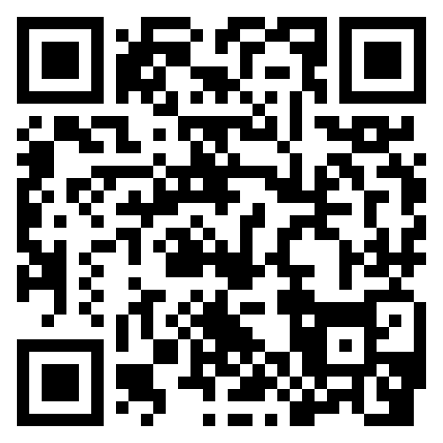
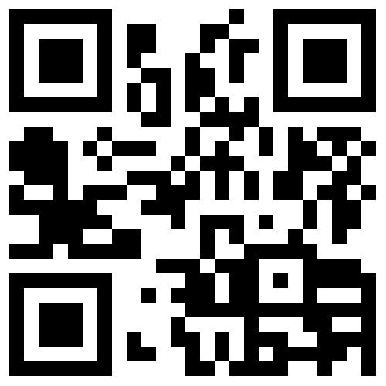
Email_to: raul.andres.leal@gmail.com
https://www.instagram.com/raul.andres.leal/
https://rauleal.com/

Slide 21
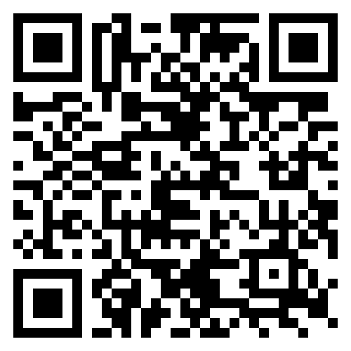
TouchDesigner Documentation
https://docs.derivative.ca/Main_Page

Slide 22
Coming up
Utrecht CCU
25th April TouchDesigner meetup
Berlin
22-23 May – European TouchDesigner event- Also online
Amsterdam
28 May – TouchDesigner meet up (Amaze/y=f(x))
Online
NODE institute - Summer sessions 2024

